Slide 1
Project Title
COVID-19 Global Analytics Dashboard
Prepared by: Christabel Ifeanyichukwu
Tool: Microsoft Power BI

Slide 2
Dataset Overview
Johns Hopkins CSSE COVID-19 dataset
Global confirmed cases, deaths and recoveries (2020–2023).

Slide 3
Business Problem
Monitor global pandemic trends, compare countries and support public health decisions.

Slide 4
KPIs Defined
• Total Confirmed Cases
• Total Recoveries
• Total Deaths
• Countries Affected
• Recovery Rate
• Average Daily New Cases
• Peak Daily New Cases
• Peak Daily Deaths

Slide 5
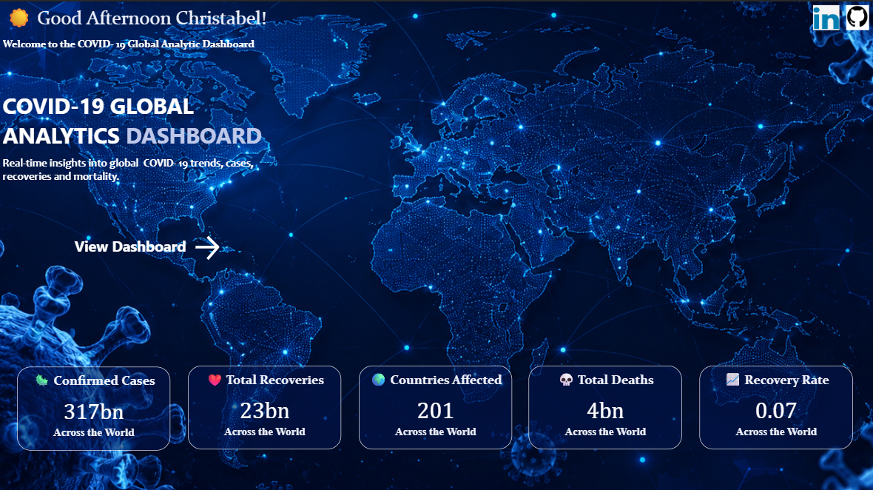
Dashboard Screenshots

Slide 6
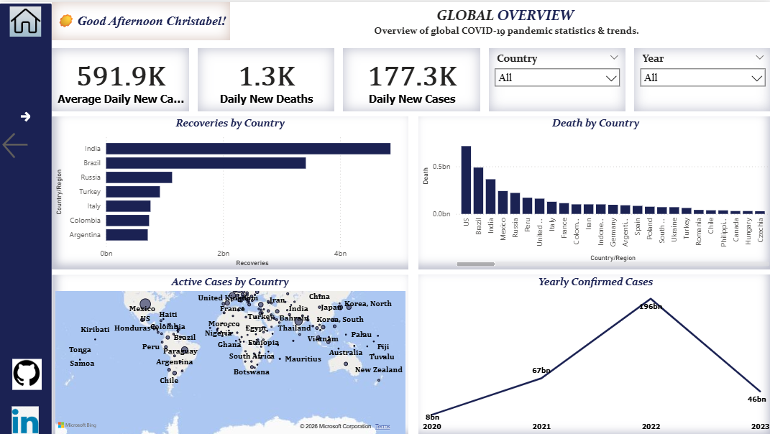

Slide 7
Key Insights
• Global cases peaked during major waves.
• Recoveries increased over time.
• Some countries recorded consistently higher cases and deaths.

Slide 8
Recommendations
• Strengthen disease surveillance.
• Support data-driven health planning.
• Monitor trends continuously.

Slide 9
Challenges Faced
• Data cleaning and unpivoting.
• Creating DAX measures.
• Designing interactive visuals.

Slide 10
Conclusion
This dashboard provides interactive insights to support data-driven decision-making.

